Slide 1
Fundamentals of AC Circuits
Module 2: Fundamentals of AC Circuits

Slide 2
Introduction to AC Circuits
Electrical appliances in the house use alternating current (AC) circuits.

Slide 3
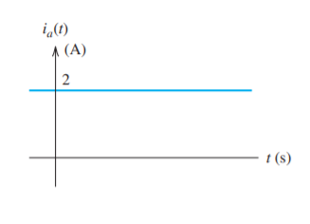
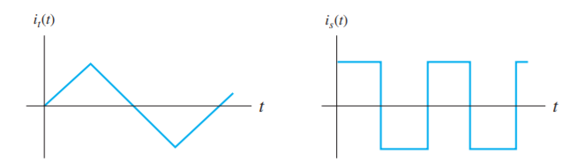
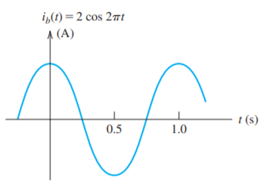
Direct Current (DC) and Alternating Current (AC)
When a current is constant with time, we say that we have direct current, abbreviated as dc
When current that varies with time, reversing direction periodically, is called alternating current, abbreviated as ac.
?

Slide 4
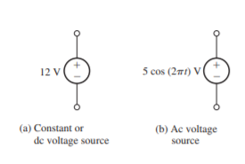
Direct Voltage (DC) and Alternating Voltage (AC)
The voltage associated with a circuit element is the energy transferred per unit of charge that flows through the element.
The units of voltage are volts (V), which are equivalent to joules per coulomb (J/C).
Voltage constant with time is called dc voltage.
Voltage that change in magnitude and alternate in polarity with time is called ac voltage.

Slide 5
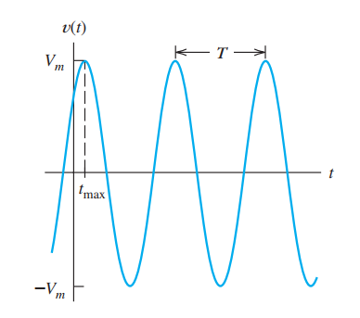
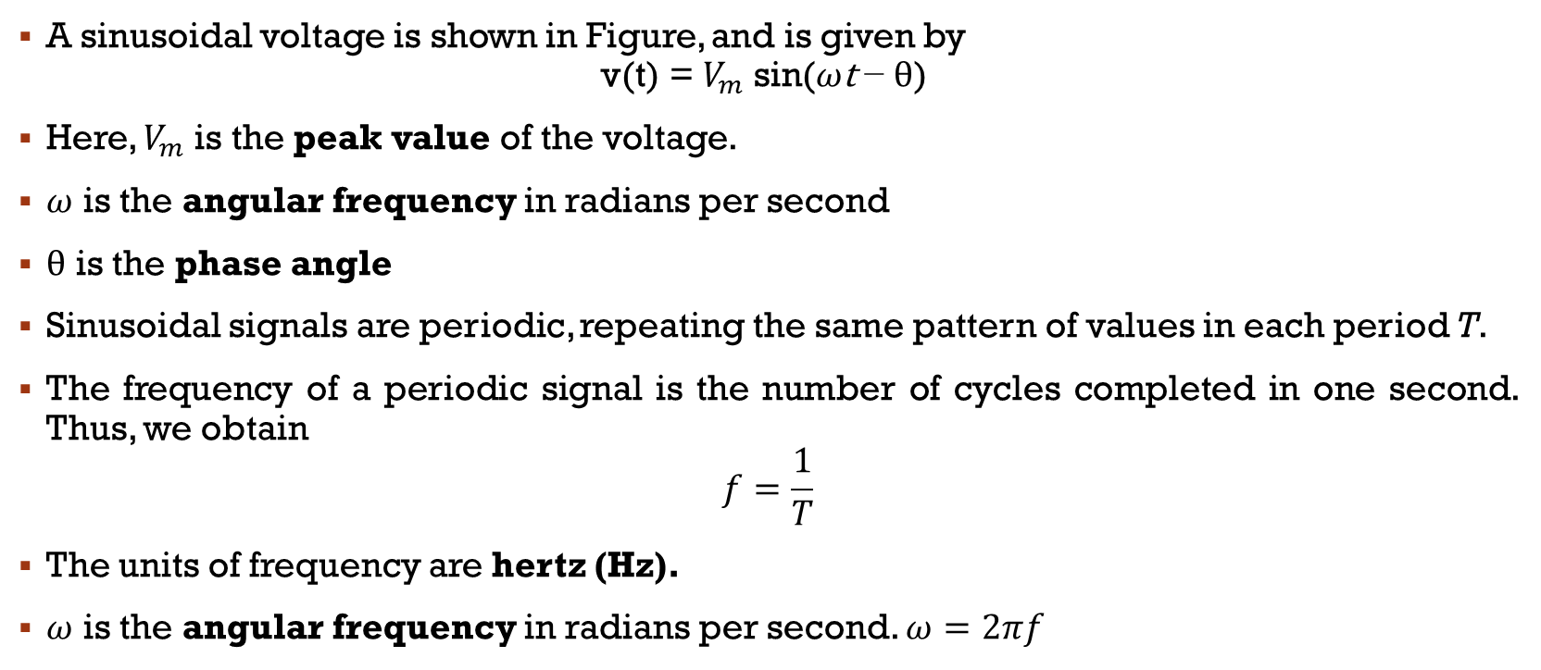
Sinusoidal AC Voltage
A sinusoidal voltage is shown in Figure, and is given by
$$\text{v}\text{(}\text{t}\text{)}\text{ = }V_{m} \text{sin}\text{(}ω\text{t} \text{−} θ\text{) }$$
Here, $V_{m}$ is the peak value of the voltage.
$ω$ is the angular frequency in radians per second
$θ$ is the phase angle
Sinusoidal signals are periodic, repeating the same pattern of values in each period T.
The frequency of a periodic signal is the number of cycles completed in one second. Thus, we obtain
$$f=\frac{1}{T}$$
The units of frequency are hertz (Hz).
$ω$ is the angular frequency in radians per second. $ω=2πf$

Slide 6
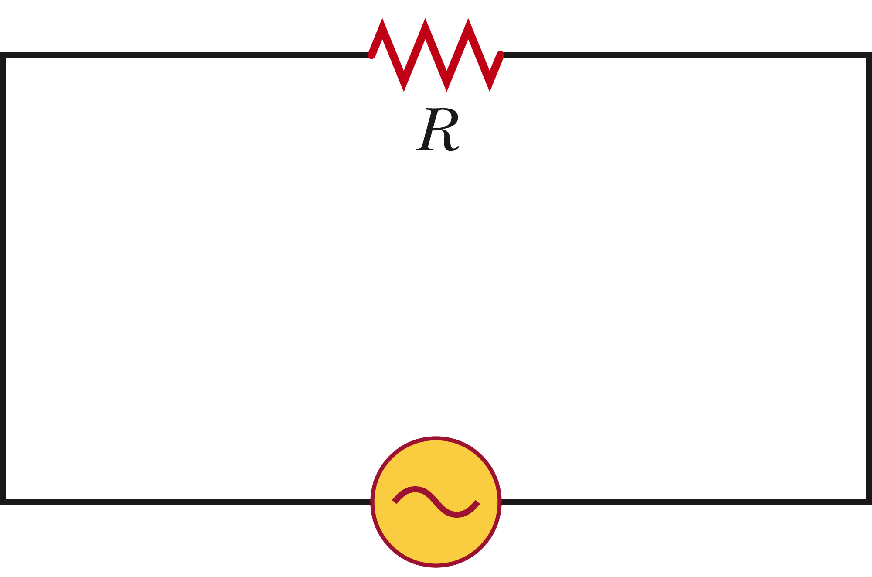
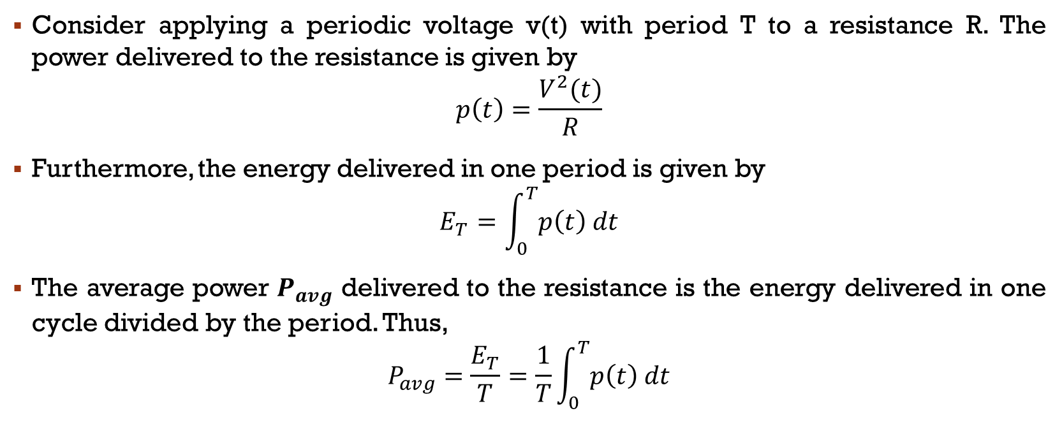
Root-Mean-Square Values
Consider applying a periodic voltage v(t) with period T to a resistance R. The power delivered to the resistance is given by
$$p\left(t\right)=\frac{V^{2}(t)}{R}$$
Furthermore, the energy delivered in one period is given by
$$E_{T}=\int_{0}^{T}{p\left(t\right) dt}$$
The average power $P_{avg}$ delivered to the resistance is the energy delivered in one cycle divided by the period. Thus,
$$P_{avg}=\frac{E_{T}}{T}=\frac{1}{T}\int_{0}^{T}{p\left(t\right) dt}$$

Slide 7
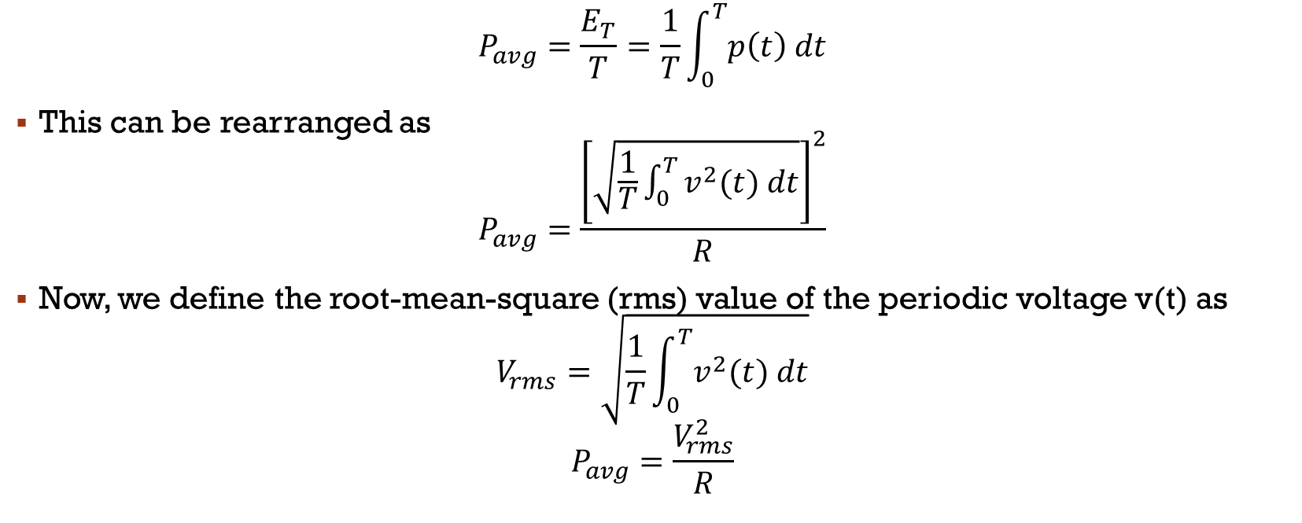
Root-Mean-Square (RMS) Values of Voltage
$$P_{avg}=\frac{E_{T}}{T}=\frac{1}{T}\int_{0}^{T}{p\left(t\right) dt}$$
This can be rearranged as
$$P_{avg}=\frac{{\left[\sqrt{\frac{1}{T}\int_{0}^{T}{v^{2}(t) dt}}\right]}^{2}}{R}$$
Now, we define the root-mean-square (rms) value of the periodic voltage v(t) as
$$V_{rms}=\sqrt{\frac{1}{T}\int_{0}^{T}{v^{2}(t) dt}}$$
$$P_{avg}=\frac{V_{rms}^{2}}{R}$$

Slide 8
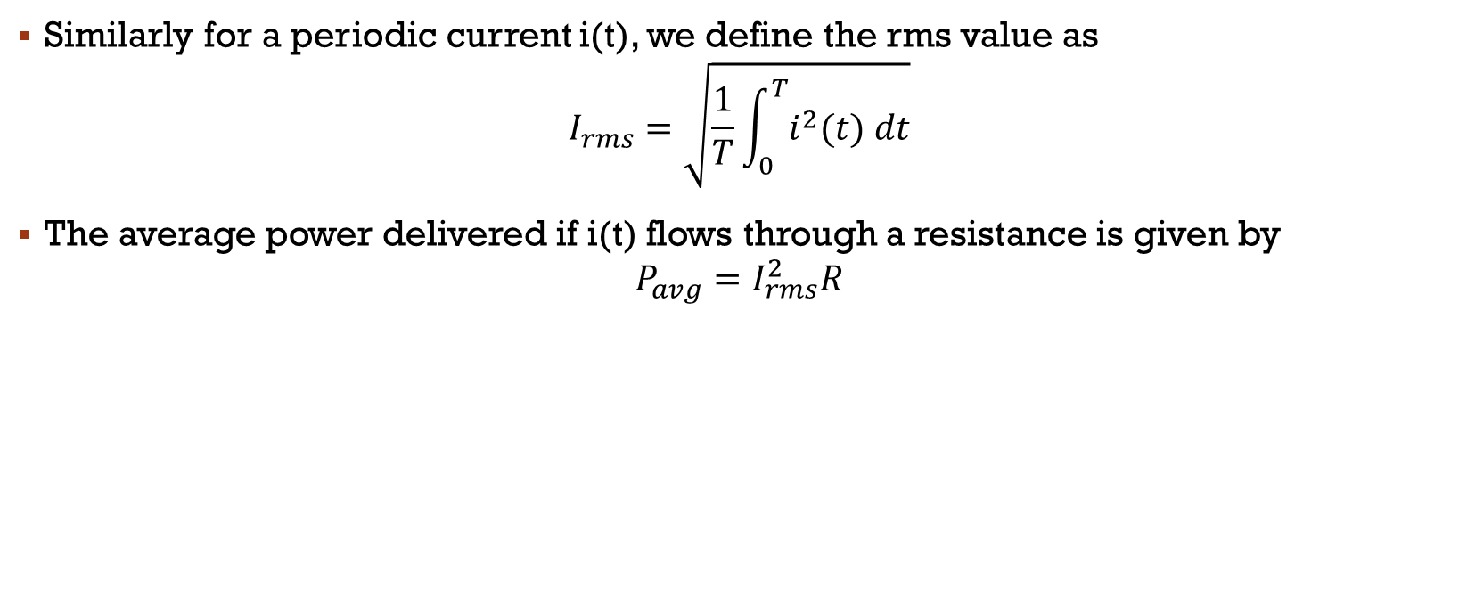
RMS Value of Current
Similarly for a periodic current i(t), we define the rms value as
$$I_{rms}=\sqrt{\frac{1}{T}\int_{0}^{T}{i^{2}(t) dt}}$$
The average power delivered if i(t) flows through a resistance is given by
$$P_{avg}=I_{rms}^{2}R$$

Slide 9


overview
$$\text{v}\text{(}\text{t}\text{)}\text{ = }V_{m} \text{sin}\text{(}ω\text{t} \text{−} θ\text{)}$$
$$f=\frac{1}{T}$$
$$ω=2πf$$
$$V_{rms}=\sqrt{\frac{1}{T}\int_{0}^{T}{v^{2}(t) dt}}$$
$$P_{avg}=\frac{V_{rms}^{2}}{R}$$
$$I_{rms}=\sqrt{\frac{1}{T}\int_{0}^{T}{i^{2}(t) dt}}$$
$$P_{avg}=I_{rms}^{2}R$$
After Substituting v(t) in $V_{rms}$
$$V_{rms}=\frac{V_{m}}{\sqrt{2}}$$
Similarly, $I_{rms}$
$$I_{rms}=\frac{I_{m}}{\sqrt{2}}$$

Slide 10
Ex 1: Power Delivered to a Resistance by a Sinusoidal Source
Suppose that a voltage given by v(t)=100cos(100wt)V is applied to a 50Ω resistance.
Sketch v(t) to scale versus time.
Find the rms value of the voltage and the average power delivered to the resistance.
Find the power as a function of time and sketch to scale

Slide 11
Ex 2 : Power Delivered to a Resistance by a Sinusoidal Source
Suppose that a sinusoidal voltage is given by
v(t) = 150 cos(200πt - 30°) V
Find the angular frequency, the frequency in hertz, the period, the peak value, and the rms value.
If this voltage is applied to a 50Ω resistance, compute the average power delivered.
Sketch v(t) to scale versus time

Slide 12
Fundamentals of AC Circuits
Module 2: Fundamentals of AC Circuits

Slide 13


sinusoidal steady-state analysis of Rl, RC & RLC Circuits

Slide 14



overview
$\text{v}\text{(}\text{t}\text{) = }V_{m} \text{sin}\text{(}ω\text{t} \text{−} θ\text{)}$
$f=\frac{1}{T}$
$ω=2πf$
$V_{rms}=\sqrt{\frac{1}{T}\int_{0}^{T}{v^{2}(t) dt}}$
$P_{avg}=\frac{V_{rms}^{2}}{R}$
$I_{rms}=\sqrt{\frac{1}{T}\int_{0}^{T}{i^{2}(t) dt}}$
$P_{avg}=I_{rms}^{2}R$
$V_{rms}=\frac{V_{m}}{\sqrt{2}}$
$I_{rms}=\frac{I_{m}}{\sqrt{2}}$

Slide 15
Phasors
Here, we will see that sinusoidal steady-state analysis is greatly facilitated if the currents and voltages are represented as vectors (called phasors) in the complex-number plane.
We start with a study of convenient methods for adding (or subtracting) sinusoidal waveforms.
We often need to do this in applying Kirchhoff’s voltage law (KVL) or Kirchhoff’s current law (KCL) to ac circuits.
For example, in applying KVL to a network with sinusoidal voltages, we might obtain the expression
v(t) = 10 cos(ωt) + 5 sin(ωt + 60) + 5 cos(ωt + 90)
To obtain the peak value of v(t) and its phase angle, v(t) = Vm cos(ωt + θ)

Slide 16
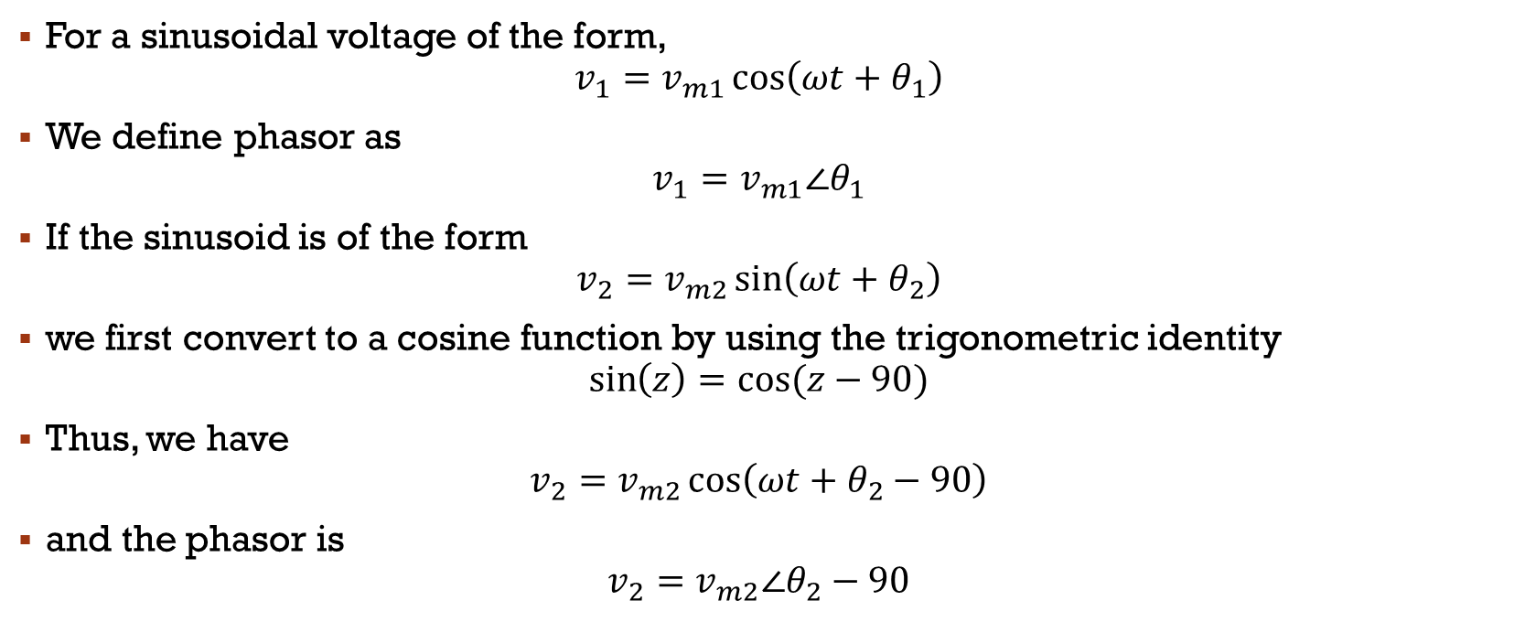
Phasor Definition
For a sinusoidal voltage of the form,
$$v_{1}=v_{m1}\cos\left(ωt+θ_{1}\right)$$
We define phasor as
$$v_{1}=v_{m1}∠θ_{1}$$
If the sinusoid is of the form
$$v_{2}=v_{m2}\sin\left(ωt+θ_{2}\right)$$
we first convert to a cosine function by using the trigonometric identity
$$\sin\left(z\right)=cos⁡(z−90)$$
Thus, we have
$$v_{2}=v_{m2}\cos\left(ωt+θ_{2}−90\right)$$
and the phasor is
$$v_{2}=v_{m2}∠θ_{2}−90$$

Slide 17

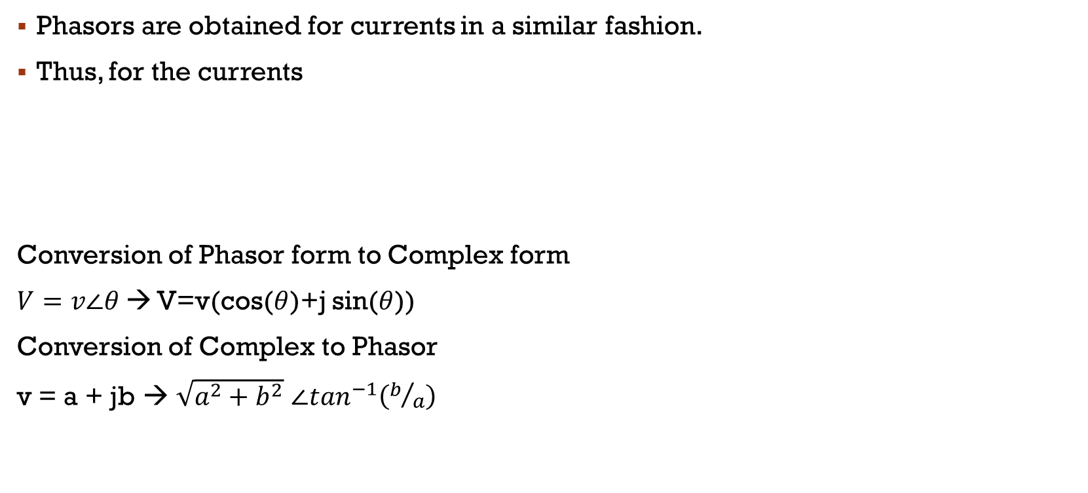
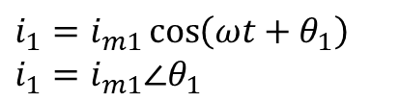
Phasor Definition
Phasors are obtained for currents in a similar fashion.
Thus, for the currents
Conversion of Phasor form to Complex form
$V=v∠θ$ → V=v(cos($θ$)+j sin($θ$))
Conversion of Complex to Phasor
v = a + jb → $\sqrt{a^{2}+b^{2}}$ $∠\tan^{−1}\left(b/a\right)$
$$i_{2}=i_{m2}\sin\left(ωt+θ_{2}\right)$$
$$i_{2}=i_{m2}∠θ_{2}−90$$
$i_{1}=i_{m1}\cos\left(ωt+θ_{1}\right)$
$i_{1}=i_{m1}∠θ_{1}$

Slide 18
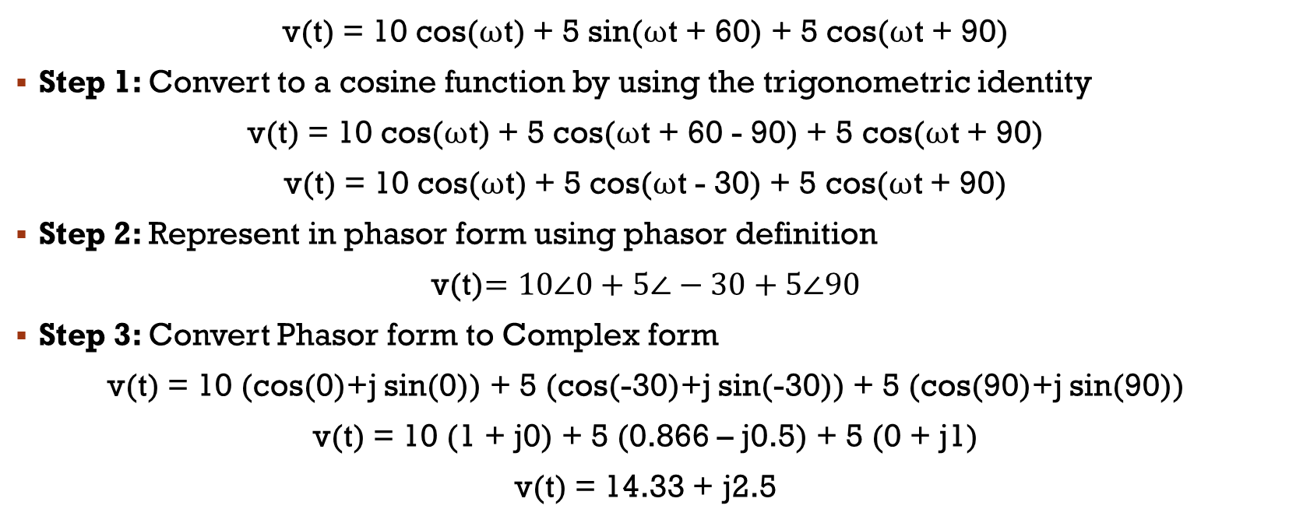
Adding Voltages Using Phasors
v(t) = 10 cos(ωt) + 5 sin(ωt + 60) + 5 cos(ωt + 90)
Step 1: Convert to a cosine function by using the trigonometric identity
v(t) = 10 cos(ωt) + 5 cos(ωt + 60 - 90) + 5 cos(ωt + 90)
v(t) = 10 cos(ωt) + 5 cos(ωt - 30) + 5 cos(ωt + 90)
Step 2: Represent in phasor form using phasor definition
v(t)$=10∠0+5∠−30+5∠90$
Step 3: Convert Phasor form to Complex form
v(t) = 10 (cos(0)+j sin(0)) + 5 (cos(-30)+j sin(-30)) + 5 (cos(90)+j sin(90))
v(t) = 10 (1 + j0) + 5 (0.866 – j0.5) + 5 (0 + j1)
v(t) = 14.33 + j2.5

Slide 19
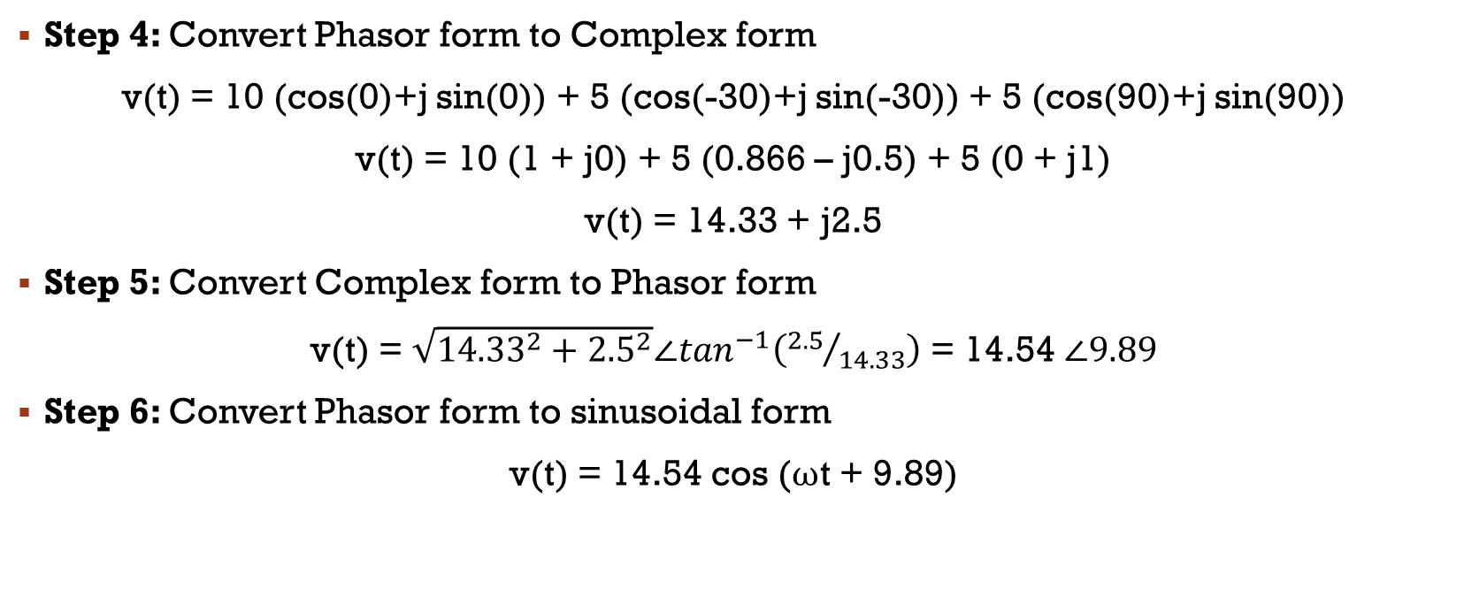
Adding Voltages Using Phasors
Step 4: Convert Phasor form to Complex form
v(t) = 10 (cos(0)+j sin(0)) + 5 (cos(-30)+j sin(-30)) + 5 (cos(90)+j sin(90))
v(t) = 10 (1 + j0) + 5 (0.866 – j0.5) + 5 (0 + j1)
v(t) = 14.33 + j2.5
Step 5: Convert Complex form to Phasor form
v(t) = $\sqrt{{14.33}^{2}+{2.5}^{2}}∠\tan^{−1}\left({2.5}/{14.33}\right)$ = 14.54 $∠9.89$
Step 6: Convert Phasor form to sinusoidal form
v(t) = 14.54 cos (ωt + 9.89)

Slide 20
Example 1: Using Phasors to Add Sinusoids
Suppose that,
v1(t) = 20 cos(ωt − 45◦)
v2(t) = 10 sin(ωt + 60◦)
Reduce the sum vs(t) = v1(t) + v2(t) to a single term.

Slide 21
Example 2: Reduce the following expressions by using phasors
v1(t) = 10 cos(ωt) + 10 sin(ωt)
i1(t) = 10 cos(ωt + 30◦) + 5 sin(ωt + 30◦)
i2(t) = 20 sin(ωt + 90◦) + 15 cos(ωt − 60◦)

Slide 22
Fundamentals of AC Circuits
Module 2: Fundamentals of AC Circuits

Slide 23
overview
$\text{v}\text{(}\text{t}\text{) = }V_{m} \text{sin}\text{(}ω\text{t} \text{−} θ\text{)}$
$f=\frac{1}{T}$
$ω=2πf$
$V_{rms}=\sqrt{\frac{1}{T}\int_{0}^{T}{v^{2}(t) dt}}$
$P_{avg}=\frac{V_{rms}^{2}}{R}$
$I_{rms}=\sqrt{\frac{1}{T}\int_{0}^{T}{i^{2}(t) dt}}$
$P_{avg}=I_{rms}^{2}R$
$V_{rms}=\frac{V_{m}}{\sqrt{2}}$
$I_{rms}=\frac{I_{m}}{\sqrt{2}}$

Slide 24
Phasor Definition
For a sinusoidal voltage of the form,
$$v_{1}=v_{m1}\cos\left(ωt+θ_{1}\right)$$
We define phasor as
$$v_{1}=v_{m1}∠θ_{1}$$
If the sinusoid is of the form
$$v_{2}=v_{m2}\sin\left(ωt+θ_{2}\right)$$
we first convert to a cosine function by using the trigonometric identity
$$\sin\left(z\right)=cos⁡(z−90)$$
Thus, we have
$$v_{2}=v_{m2}\cos\left(ωt+θ_{2}−90\right)$$
and the phasor is
$$v_{2}=v_{m2}∠θ_{2}−90$$

Slide 25
Phasor Definition
Phasors are obtained for currents in a similar fashion.
Thus, for the currents
Conversion of Phasor form to Complex form
$V=v∠θ$ → V=v(cos($θ$)+j sin($θ$))
Conversion of Complex to Phasor
v = a + jb → $\sqrt{a^{2}+b^{2}}$ $∠\tan^{−1}\left(b/a\right)$
$$i_{2}=i_{m2}\sin\left(ωt+θ_{2}\right)$$
$$i_{2}=i_{m2}∠θ_{2}−90$$
$i_{1}=i_{m1}\cos\left(ωt+θ_{1}\right)$
$i_{1}=i_{m1}∠θ_{1}$

Slide 26
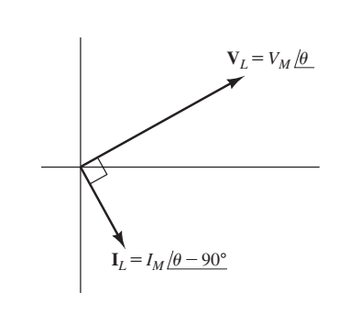
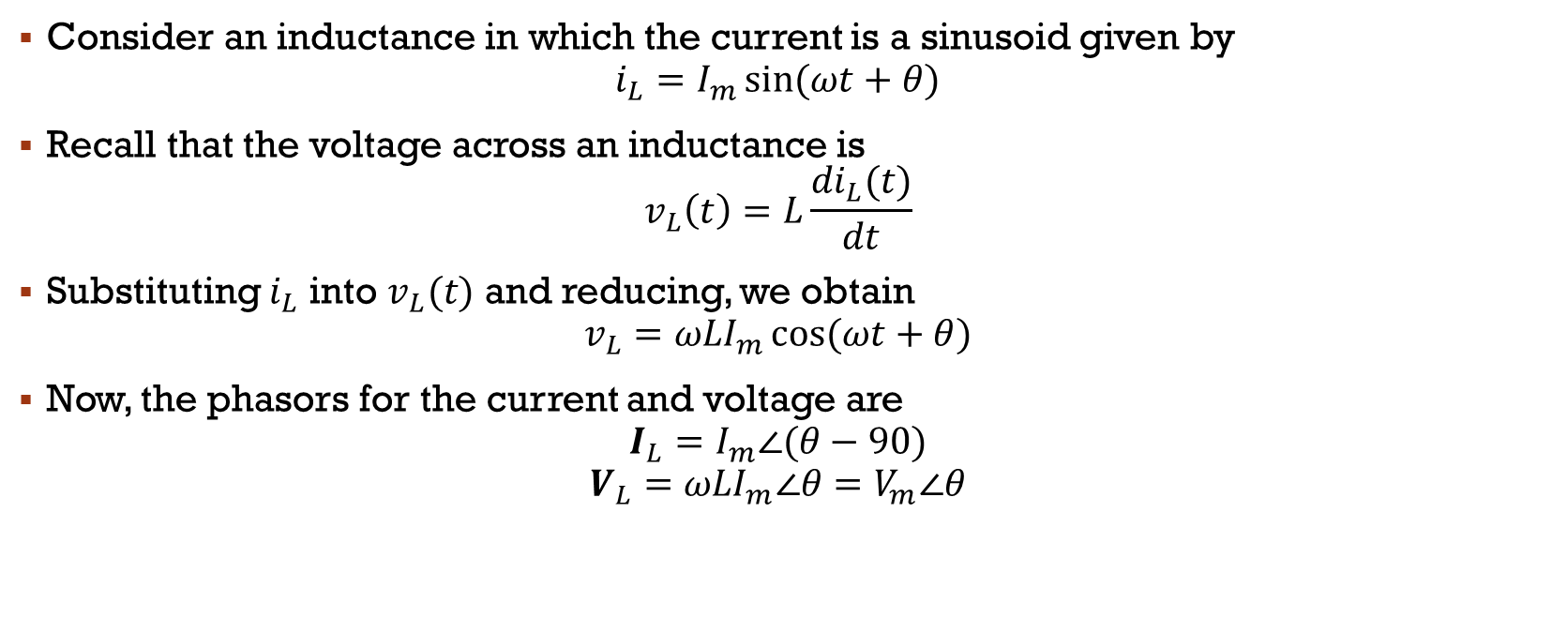
Complex impedances - Inductance
Consider an inductance in which the current is a sinusoid given by
$$i_{L}=I_{m}\sin{(ωt+θ)}$$
Recall that the voltage across an inductance is
$$v_{L}\left(t\right)=L\frac{{di}_{L}(t)}{dt}$$
Substituting $i_{L}$ into $v_{L}(t)$ and reducing, we obtain
$$v_{L}={ωLI}_{m}\cos{(ωt+θ)}$$
Now, the phasors for the current and voltage are
$$I_{L}=I_{m}∠(θ−90)$$
$$V_{L}={ωLI}_{m}∠θ=V_{m}∠θ$$
Current lags voltage by 90° in a pure inductance.

Slide 27

$V_{L}$ can we rewritten as
$$V_{L}={ωLI}_{m}∠θ$$
$$V_{L}={ωL∠90 × I}_{m}∠\left(θ−90\right)$$
$$V_{L}={ωL∠90 × I}_{L}$$
$$V_{L}={jωL × I}_{L}$$
We refer to the term $jωL=ωL∠90$ as the impedance of the inductance and denote it as $Z_{L}$.
$$V_{L}={Z_{L}×I}_{L}$$
Overview
$v_{L}\left(t\right)=L\frac{{di}_{L}(t)}{dt}$
$Z_{L}=jωL$
$V_{L}={Z_{L}×I}_{L}$
Current lags voltage by 90° in a pure inductance.

Slide 28
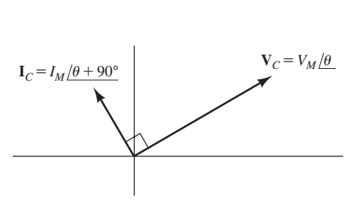
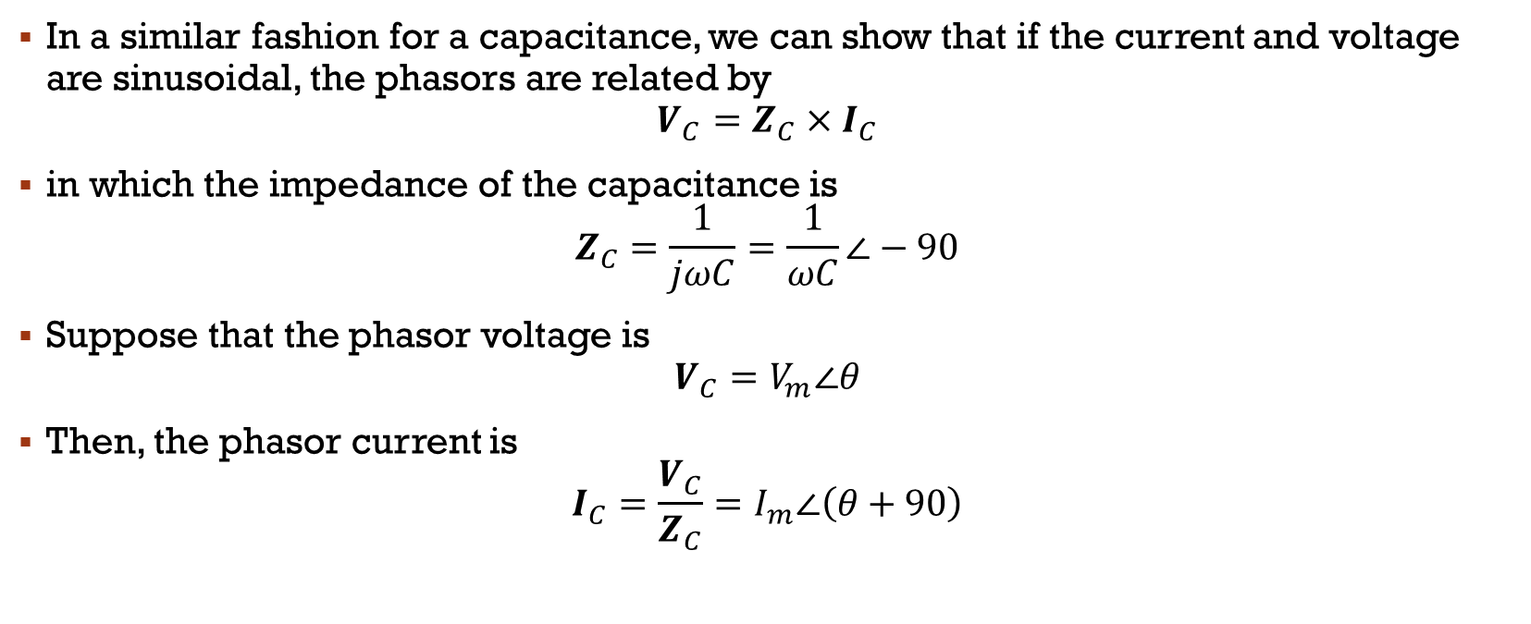
Complex impedances - Capacitance
In a similar fashion for a capacitance, we can show that if the current and voltage are sinusoidal, the phasors are related by
$$V_{C}={Z_{C}×I}_{C}$$
in which the impedance of the capacitance is
$$Z_{C}=\frac{1}{jωC}=\frac{1}{ωC}∠−90$$
Suppose that the phasor voltage is
$$V_{C}=V_{m}∠θ$$
Then, the phasor current is
$$I_{C}=\frac{V_{C}}{Z_{C}}=I_{m}∠\left(θ+90\right)$$
Current leads voltage by 90° in a pure capacitance

Slide 29
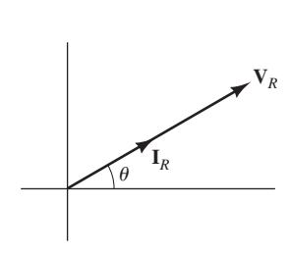

Complex impedances - Resistance
For a resistance, the phasors are related by
$$V_{R}=R I_{R}$$
Because resistance is a real number, the current and voltage are in phase
For a pure resistance, current and voltage are in phase

Slide 30
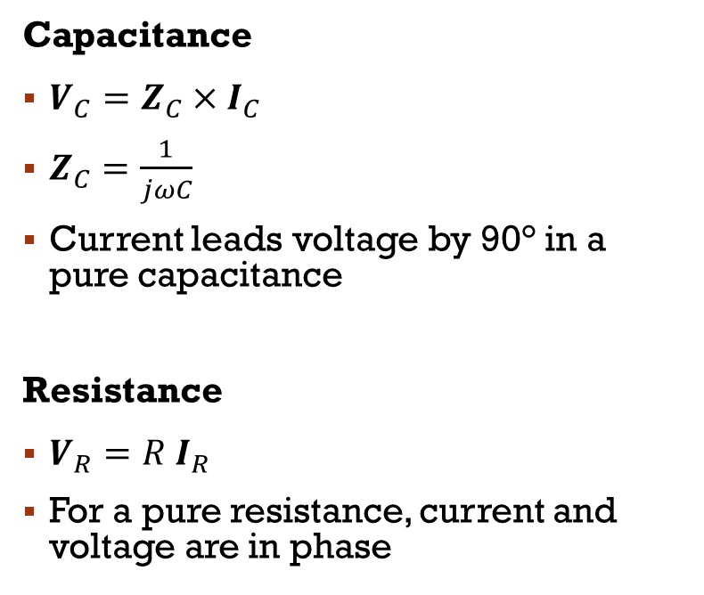
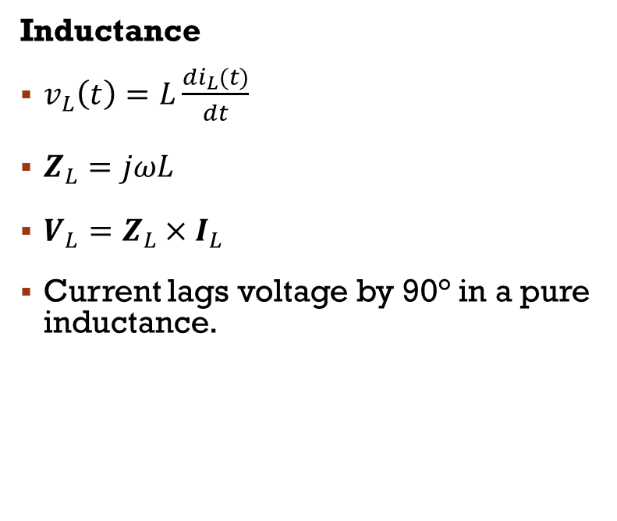
Overview
Inductance
$v_{L}\left(t\right)=L\frac{{di}_{L}(t)}{dt}$
$Z_{L}=jωL$
$V_{L}={Z_{L}×I}_{L}$
Current lags voltage by 90° in a pure inductance.
Capacitance
$V_{C}={Z_{C}×I}_{C}$
$Z_{C}=\frac{1}{jωC}$
Current leads voltage by 90° in a pure capacitance
Resistance
$V_{R}=R I_{R}$
For a pure resistance, current and voltage are in phase

Slide 31
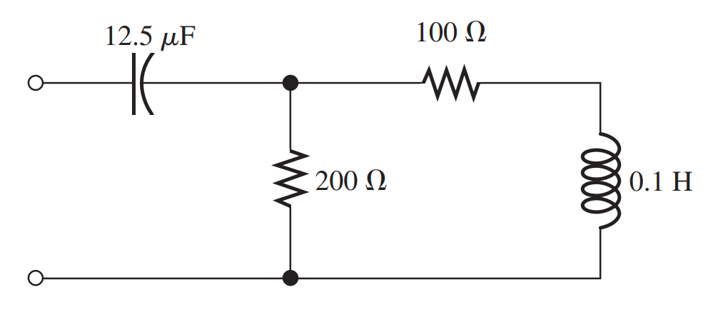

Combining Impedances in Series and Parallel – Ex 1
Determine the complex impedance between terminals shown in Figure for
$ω$ = 1000 rad/s

Slide 32
Ex 2
A voltage vL(t) = 100 cos(200t) is applied to a 0.25-H inductance. (Notice that w = 200.)
a. Find the impedance of the inductance, the phasor current, and the phasor voltage.
b. Draw the phasor diagram.

Slide 33
Ex 3
A voltage vC(t) = 100 cos(200t) is applied to a 100µF capacitance.
a. Find the impedance of the capacitance, the phasor current, and the phasor voltage.
b. Draw the phasor diagram.

Slide 34
Circuit Analysis with Phasors And Complex impedances
Kirchhoff’s Laws
Node-Voltage Analysis
Mesh-Current Analysis

Slide 35
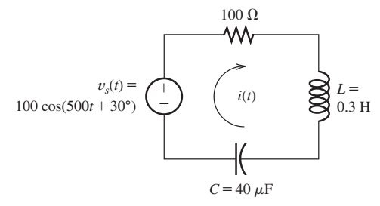
Kirchhoff’s Laws
Steady-State AC Analysis of a Series Circuit
Find the steady-state current for the circuit shown in Figure. Also, find the phasor voltage across each element

Slide 36
Fundamentals of AC Circuits
Module 2: Fundamentals of AC Circuits

Slide 37
overview
$\text{v}\text{(}\text{t}\text{) = }V_{m} \text{sin}\text{(}ω\text{t} \text{−} θ\text{)}$
$f=\frac{1}{T}$
$ω=2πf$
$V_{rms}=\sqrt{\frac{1}{T}\int_{0}^{T}{v^{2}(t) dt}}$
$P_{avg}=\frac{V_{rms}^{2}}{R}$
$I_{rms}=\sqrt{\frac{1}{T}\int_{0}^{T}{i^{2}(t) dt}}$
$P_{avg}=I_{rms}^{2}R$
$V_{rms}=\frac{V_{m}}{\sqrt{2}}$
$I_{rms}=\frac{I_{m}}{\sqrt{2}}$

Slide 38

overview
$v_{1}=v_{m1}\cos\left(ωt+θ_{1}\right)$
$v_{1}=v_{m1}∠θ_{1}$
$v_{2}=v_{m2}\sin\left(ωt+θ_{2}\right)$
$v_{2}=v_{m2}∠θ_{2}−90$
$i_{1}=i_{m1}\cos\left(ωt+θ_{1}\right)$
$i_{1}=i_{m1}∠θ_{1}$
$i_{2}=i_{m2}\sin\left(ωt+θ_{2}\right)$
$i_{2}=i_{m2}∠θ_{2}−90$
$V=v∠θ$ → V=v(cos($θ$)+j sin($θ$))
v = a + jb → $\sqrt{a^{2}+b^{2}}$ $∠\tan^{−1}\left(b/a\right)$

Slide 39
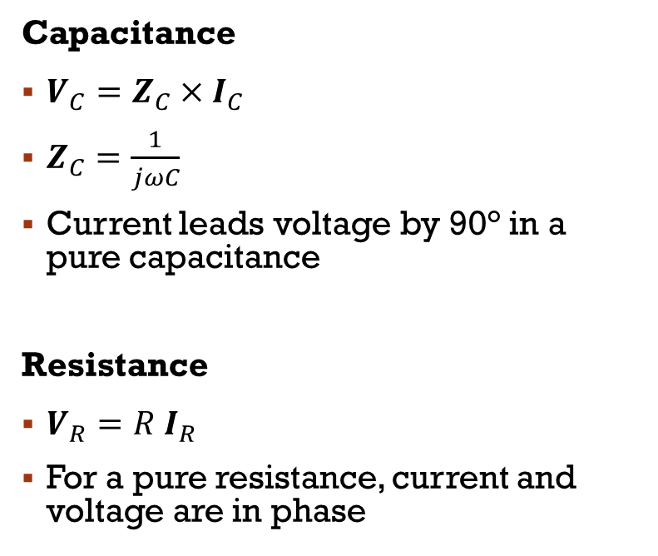
Overview
Capacitance
$V_{C}={Z_{C}×I}_{C}$
$Z_{C}=\frac{1}{jωC}$
Current leads voltage by 90° in a pure capacitance
Resistance
$V_{R}=R I_{R}$
For a pure resistance, current and voltage are in phase
Inductance
$v_{L}\left(t\right)=L\frac{{di}_{L}(t)}{dt}$
$Z_{L}=jωL$
$V_{L}={Z_{L}×I}_{L}$
Current lags voltage by 90° in a pure inductance.

Slide 40
Circuit Analysis with Phasors And Complex impedances
Kirchhoff’s Laws
Node-Voltage Analysis
Mesh-Current Analysis

Slide 41
Kirchhoff’s Laws
Steady-State AC Analysis of a Series Circuit
Find the steady-state current for the circuit shown in Figure. Also, find the phasor voltage across each element

Slide 42
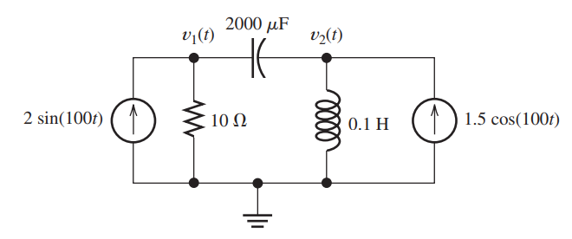
Node-voltage analysis
Use the node-voltage technique to find v1(t) and v2(t) in steady state for the circuit shown in Figure

Slide 43
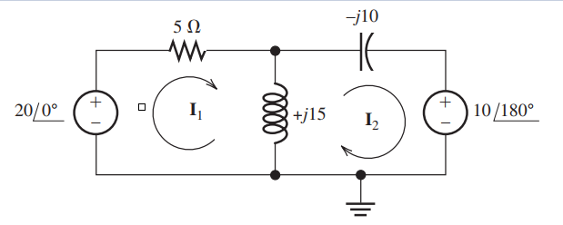
Mesh-current analysis
Solve for the mesh currents I1 and I2

Slide 44
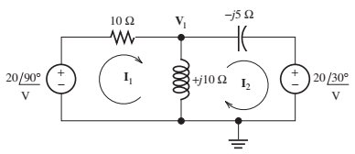
Assignment 1
Find Mesh Currents I1 and I2

Slide 45
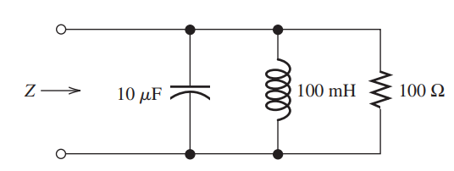
Assignment 2
Compute the complex impedance of the network shown in Figure for ω = 500. Repeat for ω = 1000 and ω = 2000. Give the answers in both polar and rectangular forms

Slide 46
Ac POWER calculations

Slide 47

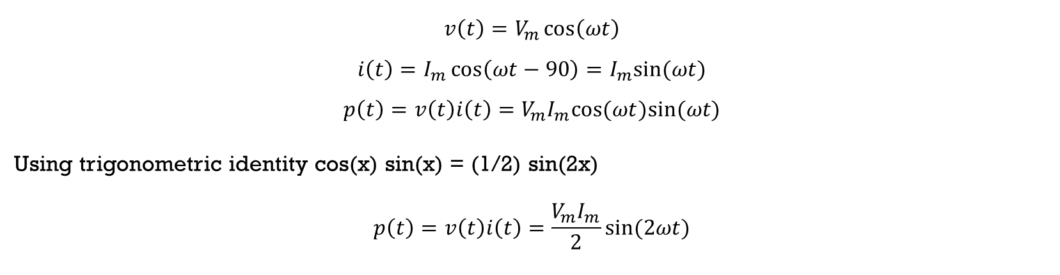
Current, Voltage, and Power for a Resistive Load
$$v\left(t\right)=V_{m}\cos\left(ωt\right)$$
$$i\left(t\right)=I_{m}cos⁡(ωt)$$
$$p\left(t\right)=v\left(t\right)i\left(t\right)=V_{m}I_{m}\cos^{2}⁡(ωt)$$
Current, Voltage, and Power for a Inductive Load
$$v\left(t\right)=V_{m}\cos\left(ωt\right)$$
$$i\left(t\right)=I_{m}\cos\left(ωt−90\right)=I_{m}sin⁡(ωt)$$
$$p\left(t\right)=v\left(t\right)i\left(t\right)=V_{m}I_{m}cos(ωt)sin⁡(ωt)$$
Using trigonometric identity cos(x) sin(x) = (1/2) sin(2x)
$$p\left(t\right)=v\left(t\right)i\left(t\right)=\frac{V_{m}I_{m}}{2}sin⁡(2ωt)$$

Slide 48

Current, Voltage, and Power for a Capacitive Load
$$v\left(t\right)=V_{m}\cos\left(ωt\right)$$
$$i\left(t\right)=I_{m}\cos\left(ωt+90\right)=−I_{m}sin⁡(ωt)$$
$$p\left(t\right)=v\left(t\right)i\left(t\right)=−V_{m}I_{m}cos(ωt)sin⁡(ωt)$$
Using trigonometric identity cos(x) sin(x) = (1/2) sin(2x)
$$p\left(t\right)=v\left(t\right)i\left(t\right)=−\frac{V_{m}I_{m}}{2}sin⁡(2ωt)$$

Slide 49
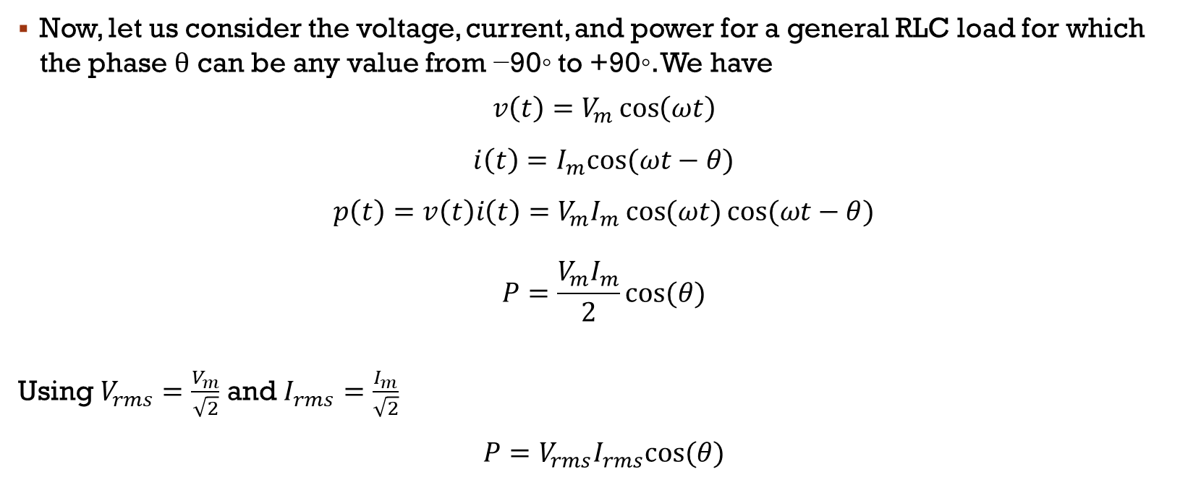
Power Calculations for a General Load
Now, let us consider the voltage, current, and power for a general RLC load for which the phase θ can be any value from −90◦ to +90◦. We have
$$v\left(t\right)=V_{m}\cos\left(ωt\right)$$
$$i\left(t\right)=I_{m}cos⁡(ωt−θ)$$
$$p\left(t\right)=v\left(t\right)i\left(t\right)=V_{m}I_{m}⁡\cos{(ωt)}cos⁡(ωt−θ)$$
$$P=\frac{V_{m}I_{m}}{2}cos⁡(θ)$$
Using $V_{rms}=\frac{V_{m}}{\sqrt{2}}$ and $I_{rms}=\frac{I_{m}}{\sqrt{2}}$ $$P=V_{rms}I_{rms}cos⁡(θ)$$
Active Power & Units (W)

Slide 50
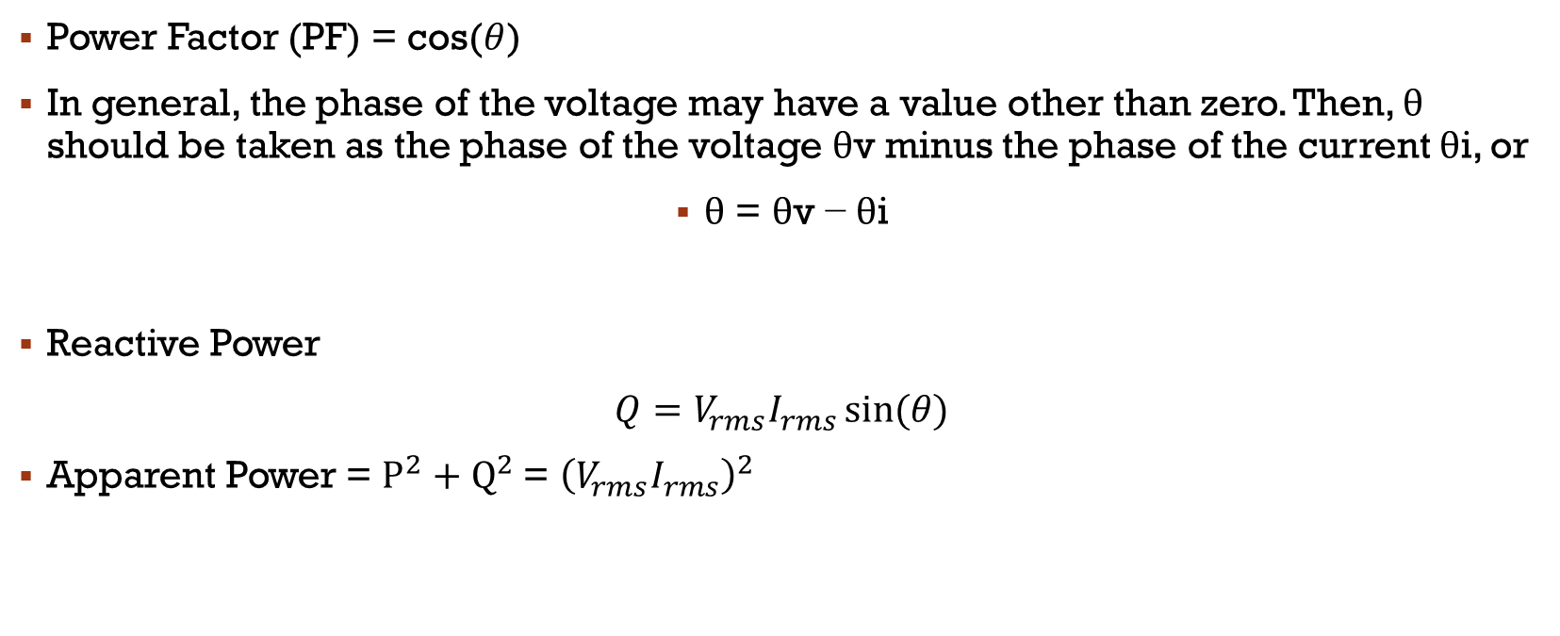
Power Factor & reactive power
Power Factor (PF) = cos($θ$)
In general, the phase of the voltage may have a value other than zero. Then, θ should be taken as the phase of the voltage θv minus the phase of the current θi, or
θ = θv − θi
Reactive Power
$Q=V_{rms}I_{rms}⁡sin(θ)$
Apparent Power = $P^{2}+Q^{2}$= ${\left(V_{rms}I_{rms}\right)}^{2}$

Slide 51
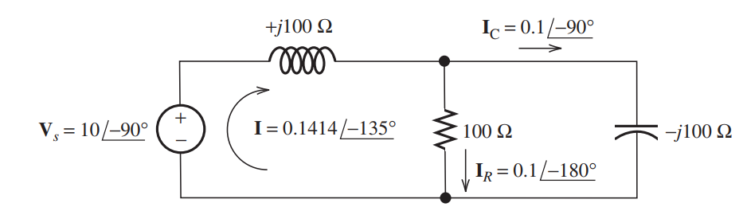
Ac power calculations
Compute the power, reactive power and apparent power taken from the source for the circuit

